Slide 1
Recap Arm Cortex Processors & Events
Pirmin Herger & Raphael Kissling
27.3.2017

Slide 2
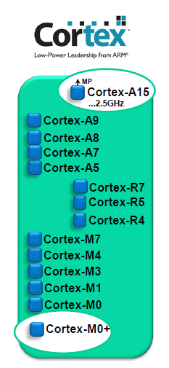
Cortex Processor Family
ARM Cortex-A: Applications processors (e.g. used in smartphones)
ARM Cortex-R: Embedded processors for real-time signal processing
ARM Cortex-M: MC-oriented, processors for MCU and SoC applications
Cortex-M7, -M4(F), -M3 (ARMv7-M)
Cortex-M0+, -M0, M1 (ARMv6-M)
Notes:
Further information:
1. 32bit Reduced Instruction Set Computer (reduced command set), constant command length of 32bit
2. Processors used for: M4 (Remote), M4F (Robot), M0+ (Freedom-Board which was used in a few teams in PREN)
3.0 ARM Inc. licenses the configurable core → they don’t produce microcontrollers
3.1 Vendors: (STM,NXP,Texas Instruments,…) implement the device/peripherals

Slide 3
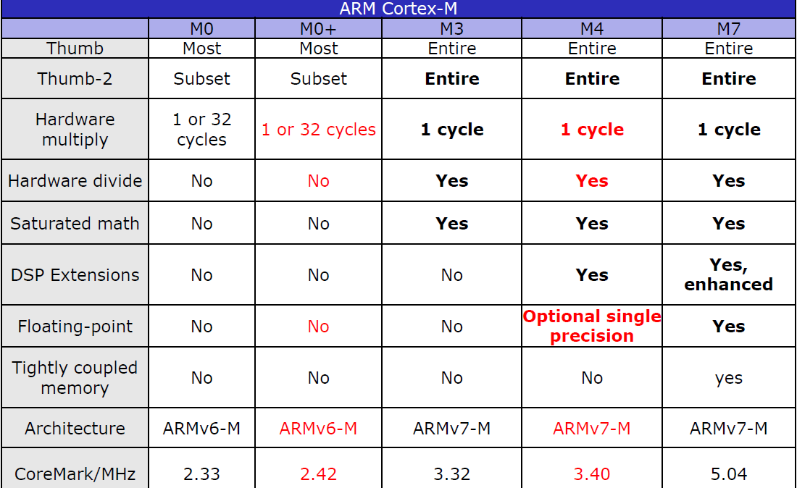
Cortex-M Comparison
Upward compatibility
Hardware multiply
1 or 32 cycles
Hardware divide
Floating-point unit (M4F)
Price:
M0: 40cents
M3-7: 3-4dollar
Notes:
Further Information:
Upward compatibility: you can use implemented code for M0 also for M4 board.
Differences M0+ and M4/M4F
32bit hardware multiply: can be synthesized with one cycle -> resulting in a larger chip area (recommended because its faster), or with 32 cycles and less chip area
Hardware divide (shared hardware): M0+ in software
30% of the silicon is for the floating point (also 30% of the price)

Slide 4
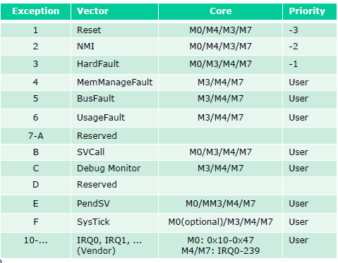
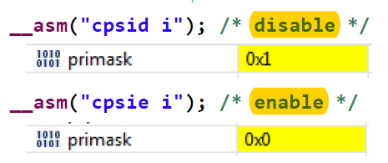
Exception Types and Primask/BasePRI
1-15: Core system exception types, >15: external interrupts (IRQ)
NMI (Non maskable interrupt)
HardFault (Hardware exception! fault -> crash!
M0: (PRIMASK only)
M4: (PRIMASK & BASEPRI)
Notes:
Further Information:
(Überleitung)
Exception 1-3: can’t change priority; the lower the number, the higher the priority (urgency)
NMI and HardFaults are not maskable (because of the negative prio!)
PRIMASK |= 1 -> all interrupts are disabled, except the first three
BASEPRI |= 4 -> interrupts 4 and higher are disabled, it’s possible to combine PRIMASK and BASEPRI. (M4)
Differences M0/M4

Slide 5
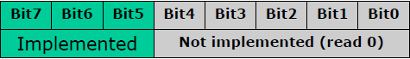
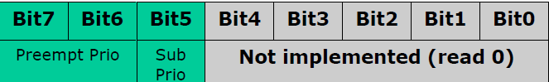
Cortex-M Interrupt Priorities
8bit Priority Register
Example: 3bits: 2^3 = 8 priorities (0x00, 0x20, 0x40, 0x80, 0xA0, 0xC0, 0xE0)
M3/M4: Preempt Prio + Sub Prio possible (the lower vector number (IRQ number) wins!)
Notes:
Further Information:
Each interrupt has a 8 bit priority register.
Subpriority: 3.1, 3.2 -> higher prio means lower number
3.1, 3.1 -> the lower vector number wins! the one with the lower IRQ numer wins!
Multiple interrupts with same priority (lower subprio value handled first)

Slide 6
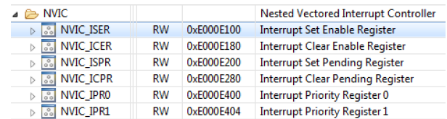
NVIC M0 and M4
Cortex-M0
2bits, 4 Prios
32 user interrupts
1bit each (1 32bit register)
NVIC_ISER, _ICER, _ISPR, _ICPR
8bits each (8 32bit register)
NVIC_IPRx
Cortex-M4
4bits 16 Prios
82 user interrupts
1bit each (4 32bit register)
NVIC_ISER, _ICER, _ISPR, _ICPR, NVIC_IABR
8bits (106 32bit register)
NVIC_IPRx
Notes:
Further Information:
NVIC: Cortex-M0
32 user interrupts (0x10-0x47)
1 bit each (1 32bit register)
NVIC_ISER (Interrupt Set Enable Register)
NVIC_ICER (Interrupt Clear Enable Register)
NVIC_ISPR (Interrupt Set Pending Register)
NVIC_ICPR (Interrupt Clear Pending Register)
8 bits each (8 32bit register) NVIC_IPRx (Interrupt Priority Registers)
NVIC: Cortex-M4
82 user interrupts (0x10-0x61)
1 bit each (4 32bit register) NVIC_ISER (Interrupt Set Enable Register)
NVIC_ICER (Interrupt Clear Enable Register)
NVIC_ISPR (Interrupt Set Pending Register)
NVIC_ICPR (Interrupt Clear Pending Register)
NVIC_IABR (Interrupt Active Bit Register)
- 8 bits each (106 32bit register) NVIC_IPRx (Interrupt Priority Registers)

Slide 7
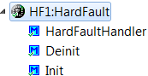
Fault Exception and Hard Fault Handler
Bus Fault – Instruction or data error, stacking error
Memory Fault – Write to read-only, outside of memory map
Usage Fault – illegal instruction, invalid ISR return, unaligned memory access
Conclusion: Hard Faults can be called by above faults conditions!
Hard Fault Handler
Interrupt handler (or debugger) to read:
Link register
PC register
Notes:
Further Information:
Interrupt handler (or debugger) to read special registers and location to find out location of problem.
Hard Fault stack frame different from normal ISR frame

Slide 8
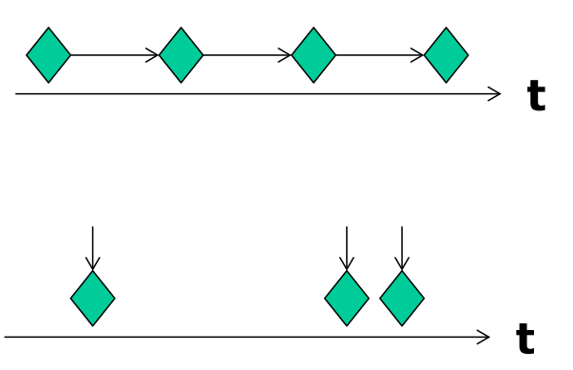
Events
two different main types
Synchronous (e.g. Timer Interrupt, Periodic Task
output) and Asynchronous (e.g. Button Pressed)
Need Infrastructure (Set/clear/check if event
happened)
Implementation → RTOS or ‘Flags’ → possible Implementation: Queue, List, Array
Notes:
-two different main types → Synchronous and Asynchronous Events
-the picture shows the two different types, on top are synchronous events with a defined clock frequency → for example a timer interrupt. It is defined when a interrupt occurs
-on bottom of the picture is an example of asynchronous events → this type of event occurs on a random time → for example when a button is pressed
It needs infrastructure to handle with events → I will show that point later in this presentation
- There are different implementation of events → on one hand with RTOS and on the other hand with flags and also different Implementations where the events are stored, for example a queue, list or with an array. In this presentation ist the focus on flags and arrays.

Slide 9
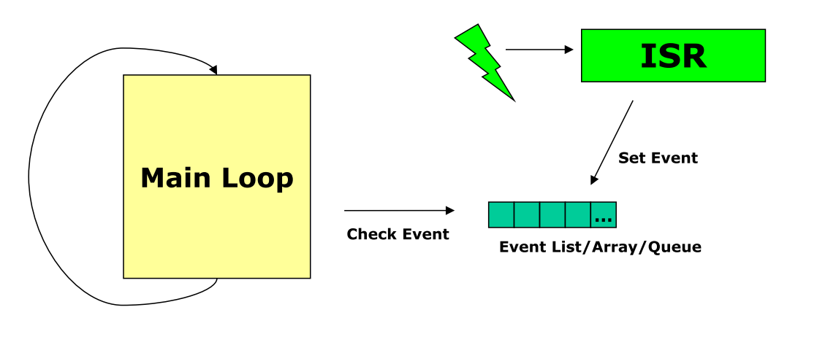
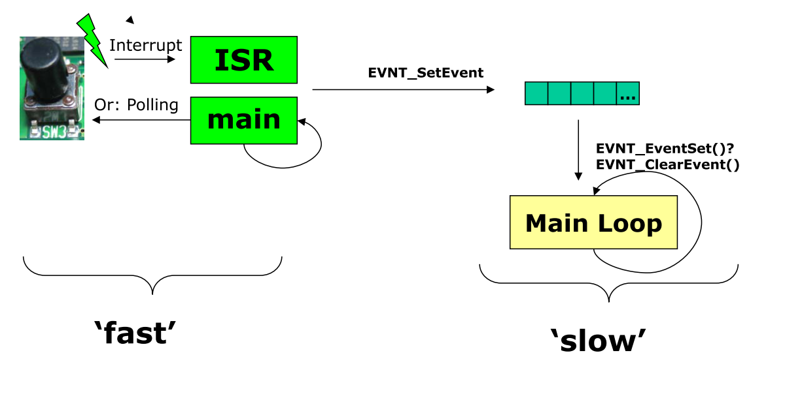
Execution Speed / Decoupling Event and Processing
ISR: as efficient and straight
forward as possible
Main loop does the ‘heavy’
workload
Interrupt Service Routines:
Create/Set events (flags)
Notes:
The picture on top shows the workflow of an event.
1. Interrupt occurs, for example Buttton pressend
2. A flag is set in the Interrupt Service routine and so the event ist stored in an Event Array
3. The main program/loop checks if an event is in the array and then handle the event
So the ISR has to be as efficient and straight forward as possible and the main loop does the heavy workload. That means it handle the events and do what is needed.
The ISR just sets the Event Flag
In the picture below there is the same workflow with the methods wich are implemented in our intro projects. We see another aproach with polling for example a button state frequently in the main loop
and then set an event if the state is changed.

Slide 10
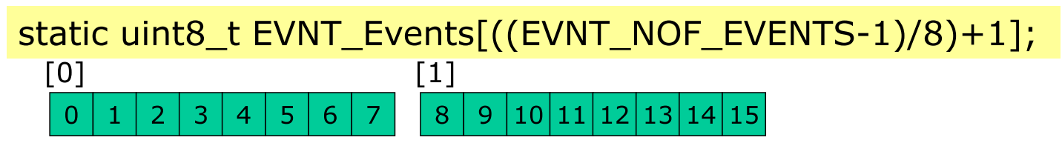

EVNT Array
Bit operations to keep the amount of memory as small as possible
EVNT Array
Set Event
Notes:
-Example EVNT Array with EVNT_NOF_EVENTS = 8

Slide 11
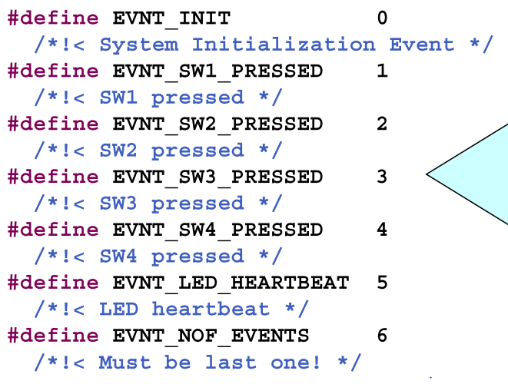
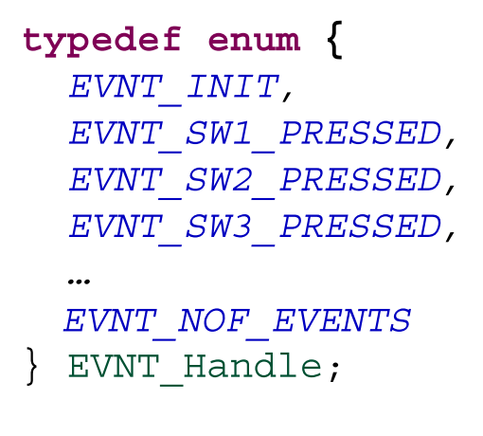
Storing Events
Definition of all the Events → mapping from numbers to names
Implementation with #define or enumeration
Event Number could be used as priority
What if we need to add an event?
Notes:
- Erwähnen dass EVNT_NOF_EVENTS am Schluss stehen muss, da Array Definition ist abhängig davon

Slide 12
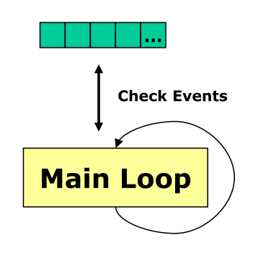
Handling Events from Main Loop
Iterate from main loop through event array
Check if there is an event and extract it
Handle event according to the event (e.g. flash LED’s)
Advantage: simple implementation
but: Long if/else/switch statements, need
to protect against concurrent access!

Slide 13
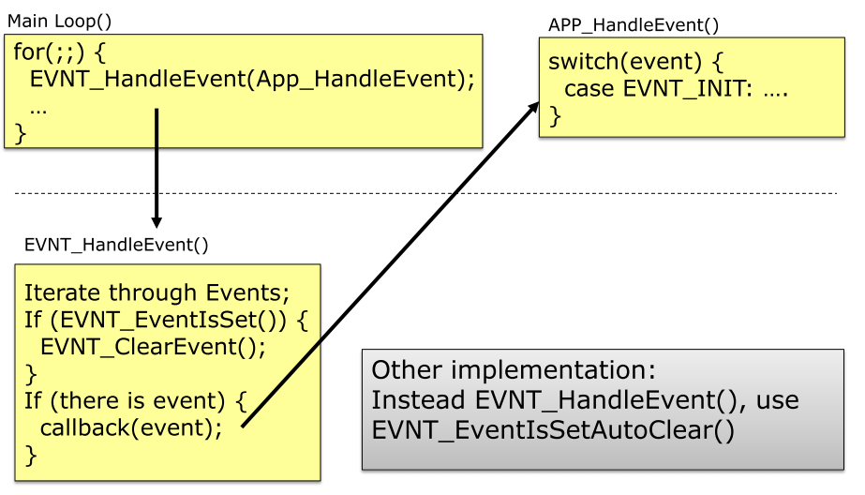
Event Handle: Workflow MAIN Loop

Slide 14
Questions
Which ARM processors are used for…?
Robot
Remote
Freedom-Development Board (e.g. FRDM-KL25Z )
ARM Cortex allowed 32 bit hardware multiply synthesized by one or 32 cycles. What’s the different?
3. What is important to consider if you add and define a new event?
4. Why do you have to make the event methods reentrant (critical section)?

Slide 15
Answers
ARM processors:
Robot (M4F)
Remote (M4)
Freedom-Development Board (M0+)
32bit hardware multiply can be synthesized with one cycle, resulting in a larger chip area (recommended because it’s faster) or with 32 cycles and less chip area.
3. A new event has to be above the EVNT_NOF_EVENTS
4. Because a ISR and the main loop have acces to the Event Array

